Slide 1
What is the pathological short stature?

Slide 2
Systemic disorders or processes with secondary effects on growth
Endocrine causes of short stature
Genetic
Skeletal Dysplasia

Slide 3
What is the contitustional short stature ?
Children with CDGP are usually of normal size at birth.
By three or four years of age, children with CDGP usually are growing at a low-normal rate
Adult height is normal
Bone age is retarded
Puberty is not appropriate for age

Slide 4
What are the features of bronchiolitis?

Slide 5
Usually seen under 2 years of age
More often in autumn and winterbeing seen
Risk of hospitalization between 2-6 monthshigher
under 5 years old especially under 2 years old most frequent hospitalization in children

Slide 6
Factors???

Slide 7
Factors??
RSV
Parainfluenza
İnfluenza virüs
Adenovirüs
Rhinovirüs
Enterovirüs
Bocavirüs
Metapnömovirüs
Coronavirüs
Mycoplasma pneumoniae
Chlamydia trachomatis

Slide 8
Would you classify community-acquired pneumonia

Slide 9
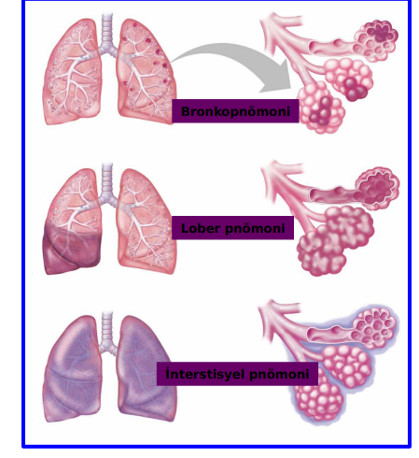
according to factor and involvement

Slide 10
Which patient should be hospitalized?

Slide 11
Age < 6 months
Acute chest syndrome in sickle cell anemia
Multiple lobe involvement
Immunocompromised patient
Toxic appearance
Moderate or severe respiratory distress
The need for oxygen therapy
Complicated pneumonia
Dehydration Vomiting or inability to take medications and fluids by mouth
Unresponsiveness to appropriate oral antibiotics
Social factors (problems with monitoring at home, etc.)

Slide 12
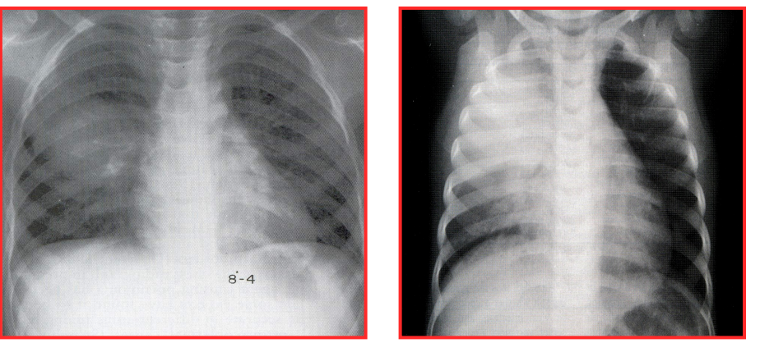

Slide 13
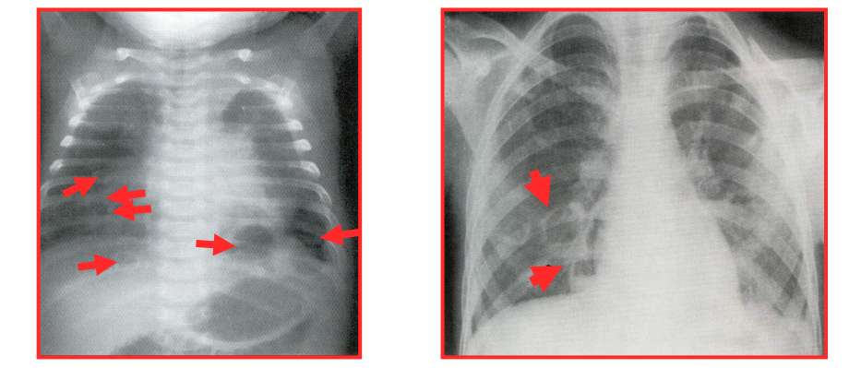

Slide 14
??

Slide 15
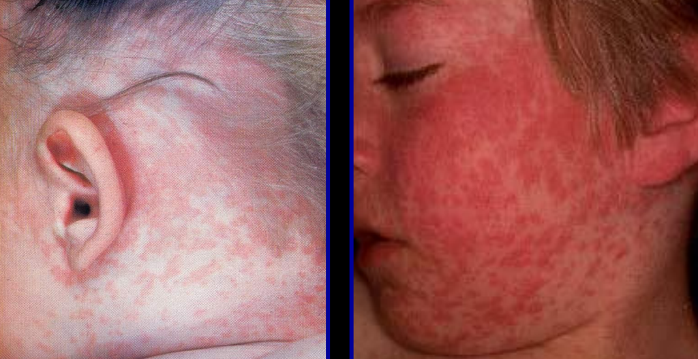

Slide 16
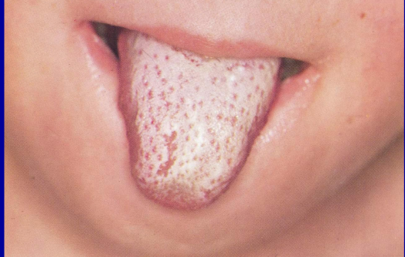
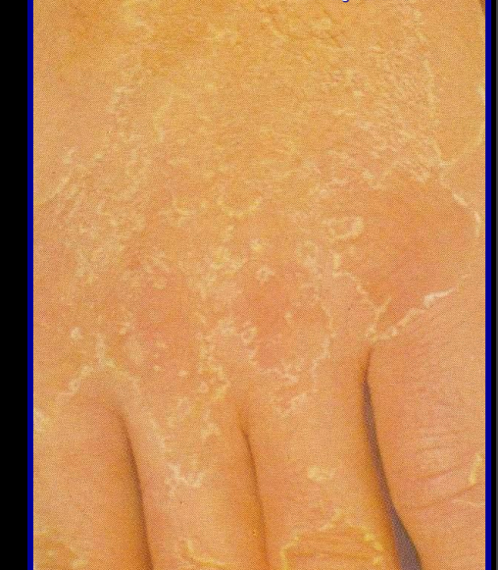
Which disease suggest?

Slide 17
What are the complications of disease which is shown ?

Slide 18
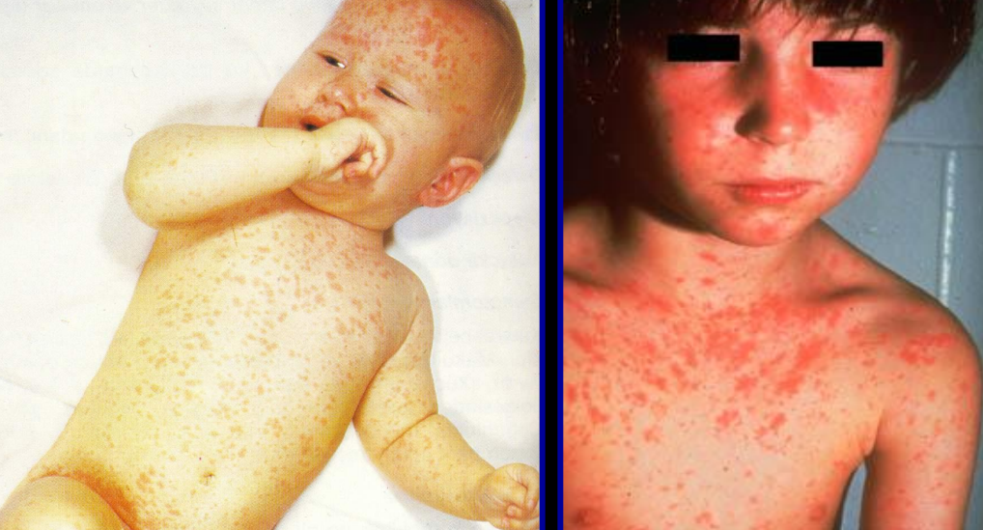
???

Slide 19
Encephalitis
Progressive rubella panencephalitis,
Thrombocytopenia,
Arthralgia,
arthritis
Congenital rubella syndrome

Slide 20
What are common problems seen in an infant of a diabetic mother?

Slide 21
Disorders of growth
Birth injury
Metabolic and hematologic disorders
Cardio-respiratory disorders
Congenital malformations

Slide 22
Is it necessary to check blood sugar level in all newborns?

Slide 23
Answer is NO
(AAP, 2011 and PES)
Asymptomatic healthy newborn born at term to an uneventful pregnancy: NO NEED TO CHECK BLOOD GLUCOSE
Infants who are at risk for hypoglycemia and symptomatic infants: GLUCOSE SCREENİNG İS NECESSARY

Slide 24
Which infants are at risk for hypoglycemia?

Slide 25
Late-preterm infants
Term SGA infants
Infants of diabetic mother
LGA infants (beyond 34 w)

Slide 26
Please list physiological skin findings in a newborn (5 will be enough)

Slide 27
Erythema Toxicum Neonatorum
Transient Neonatal Pustular Melanosis
Mongolian spots
Milia
Acne Neonatorum
Salmon patch

Slide 28
When do you suspect an abnormal external genitalia ?

Slide 29
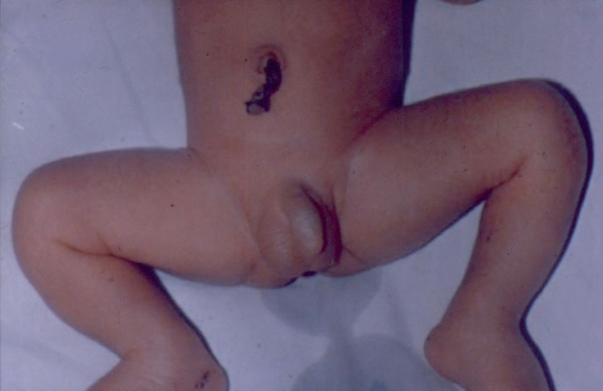
Internal and external reproductive organs in male
bladder
prostate
urethra
Notes:
The normal male infant should have adequate penile structure, normal urethral opening on the glans, and palpable scrotal testicles

Slide 30
Streched penile length should not be less than 2 cm in a normal baby boy
Pediatric surgery consultation if testicles have not descended in the first 6 months
How low is the hypospadias located? It's that important

Slide 31
What are the pathlogical findings for external genitalia in a girl?

Slide 32
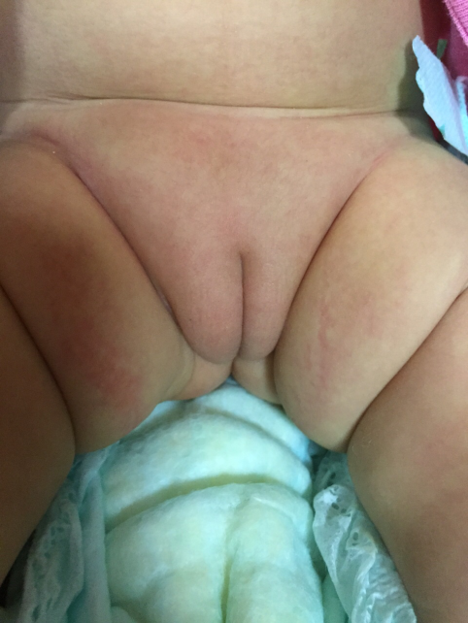
Internal and external reproductive organs in female
Fallopian tube
Labia majora
Clitoris
Urethra
Ovary
Labia minora
Uterus
Vagina
Cervix
Vagina
Anus

Slide 33
Vaginal opening should be seen in every baby girl
Labia minora fusion is not a sign of virilization
No mass in the inguinal canal and labia majora
It should not be rushed to say cliteromegaly in preterms
Clitoris over 8mm in term babies requires examination

Slide 34
What is the Classification of disorders of sex development (DSD)?

Slide 35
Sex Chromosome DSDs
47,XXY
Kline felter 1/500-1000
45,X Turner 1/2500
45,X/XY
46,XX/46,XY
DSD with atypic genitalias
46,XY DSDs
1/ 20000
46,XX DSDs
1/14000-15000
Disorders of andogen synthesis/ androgen action
Associated with androgen biosynthesis
Disorders of androgen action
Complete or partial insensitivity syndrome
persistent mullerian duct syndrom
Endocrine disruption
Syndromic forms
Unclassified
Disorders of androgen excess
Disorders of testicular
development
Disorders of ovarian
development
Intersex İnsidance: 1/4500-1/5500
Notes:
DSDs aetiology is very heterogenous which is chromosomal, gonadal or anatomical. Clasification has three subclasses

Slide 36
When do you think androgen excess in a girl?

Slide 37
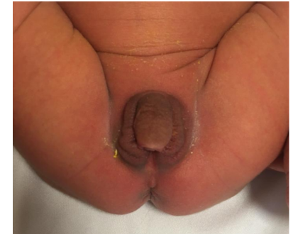
46,XX DSD’s with androgene ecsess
Karyotype : 46, XX
Gonads : Bilateral Ovary
Müller (Uterus) : +
External genitalia : Virilized

Slide 38
Attention with 46,XX infants should be focused on the external genitalia:
Ambigus genitalia with gonads are not palpable
Palpation of the gonad excludes it.
The absence of vaginal opening is the result of labia majora fusion.
Not to be confused with fusion of the labia minora.
Although genital hyperpigmentation is a clue but it makes the approach difficult in the dark skinned baby.
17OHP values should be interpreted with family history, physical examination, and baby's gestation age and birth weight.

Slide 39
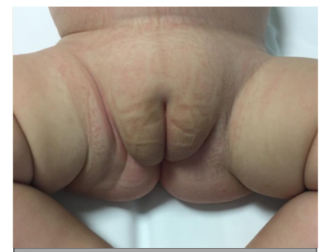
46,XY DSDs
İnsidance: 1/20 000
Karyotype : 46, XY
Gonads : Bilateral Testis
(Intra abdominal – inguinal – scrotal,
Uterus : ±
Wolf fian duct : ±
Prostate : ±
Notes:
According to disorder whether there is a uterus,

Slide 40
DIFFERENTIAL DIAGNOSIS
History:
Maternal drug use during pregnancy
Maternal virilization history
prenatal history
Consanguinity
Presence of a similar history
in the family
PE:
Presence of palpable gonad
Accompanying other system findings
location of the urogenital sinus
Genital hyperpigmentation
It should be especially evaluated
Lab
Imaging structures of gonads
Uterus ?
Karyotype ?
17 - OHP ?/Hormonal studies
What is the Structure of the Gonad?
Are There Wolffian Structures?
Functional Status of the Gonad?
Risks of gonadal malignancy
What is the Response to
Exogenous Testosterone Therapy?
Molecular genetic diagnosis

Slide 41
Why is the important NST for babies?

Slide 42
Most newborn babies have few or no clinical manifestations of thyroid hormone deficiency.
The majority of cases are sporadic, so it is not possible to predict which infants are likely to be affected.
It is aimed to diagnose as early as possible by measuring thyroxine (T4) or thyrotropin (thyroid stimulating hormone [TSH]) in blood samples taken from the heel.
preventable mental retardation

Slide 43
What are the causes of CH?

Slide 44
Etiology
embryologic defect in thyroid gland development (dysgenesis) or
a defect in thyroid hormone synthesis(dyshormonogenesis).
Congenital Hypothyroidism
Permanant Congenital Hypothyroidism
Transfer of maternal antithyroid drugs,
Maternal thyroid-stimulating hormone (TSH) receptor-blocking antibodies,
Exposure to excess iodine,
Large hepatic hemangiomas, and some DUOX2 gene mutations
Transient Congenital Hypothyroidism
Dysgenesis
Primary
Central
Dyshormonogenesis

Slide 45
Which patients have risk for Central CH?

Slide 46
What does it mean that Transient CH?

Slide 47
What should be the treatment dose?

Slide 48
Management of childhood poisoning

Slide 49
Case
An 11-month-old boy who has no prior medical history presents with ingestion of paracetamol. He has no complaints. In his story, you learn that he drank the medicine called Calpol suspension, which was written for his brother, and the bottle was half full. Two hours have passed since taking the drug.
On examination, he is playing with his toys on the stretcher. The boy weighs 8 kg, and his vital signs are rectal temperature, 36.5°C; heart rate, 105 beats/min; blood pressure, 90/65 mm Hg; respiratory rate, 22 breaths/min; oxygen saturation, 97% on room air. His abdomen is soft, with no tenderness elicited on palpation. His capillary refill is <2 seconds. He has a watery, yellow-colored stool in his diaper.
How do you manage the patient?

Slide 50
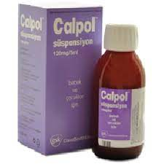
150/2= 75 ml
75 ml=15 scupe
15x120=1800 mg paracetamol
1800/8=225 mg/kg
150 ml

Slide 51
Rumack-Matthew Nomogram
Paracetamol (Acetaminophen)

Slide 52
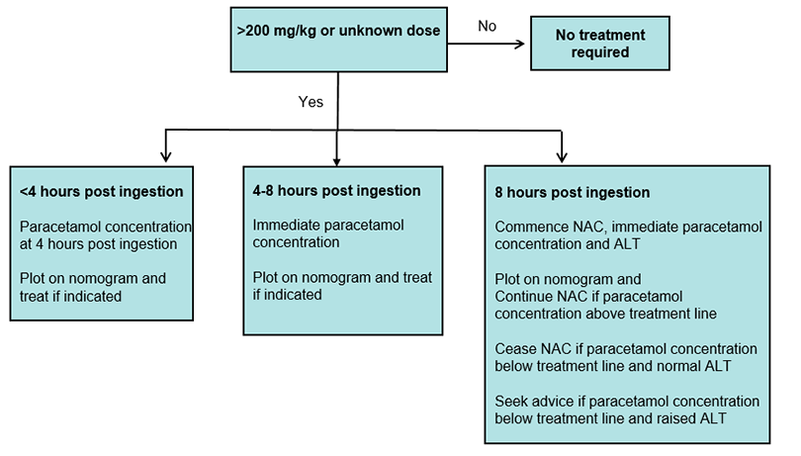
Paracetamol (Acetaminophen)

Slide 53
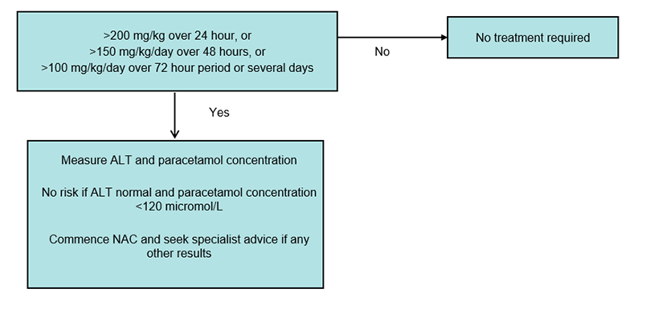
Paracetamol (Acetaminophen)

Slide 54
N-Acetyl Cysteine
Paracetamol (Acetaminophen)
 | ORAL | IV
Total | 1330 mg /kg/ 72 h | 300 mg/kg/21 h
Loading dose | 140 mg/kg | 150 mg/kg/60 min
 | 70 mg/kg 17 times at 4-hour intervals | 50 mg /kg/ 4 h 100 mg/kg/16 h

Slide 55
What type of undernutrition may be irreversible?
A) Underweight
B) Wasting
C) Stunting
D) Micronutrient deficiency

Slide 56
Please tell the risk factors of malnutrition

Slide 57
Risk factors
Prematurity
Small for gestational age
Maternal disease (Chronic disease, depression…)
Chronic disease of the child (allergy, chronic renal disease, chronic liver disease, cystic fibrozis, chromosomal abnormallities, conjenital heart defects, malignency, malabsorption….)
Socioeconomic factors (poverty, low education level…)

