Slide 1
Pubertal Disorders

Slide 2
3.5 years old boy
Admitted to outpatient clinic because of laughing fits that started 5 months ago
The laughing episodes increase with emotional situation( with stresses and sadness)
And pubic hairy and penis enlargement was noticed by his mother

Slide 3
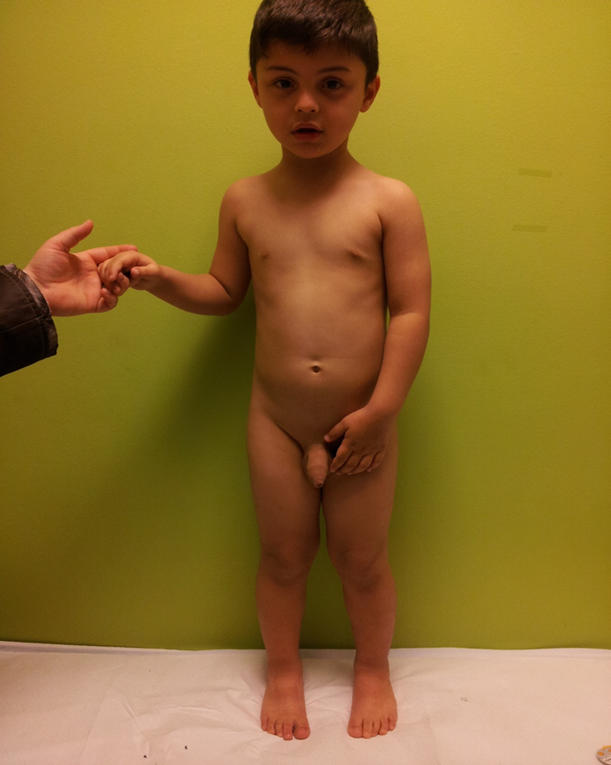

Slide 4
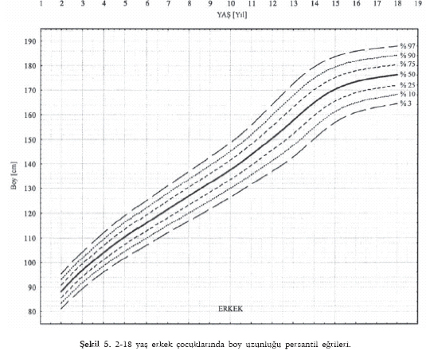

Slide 5
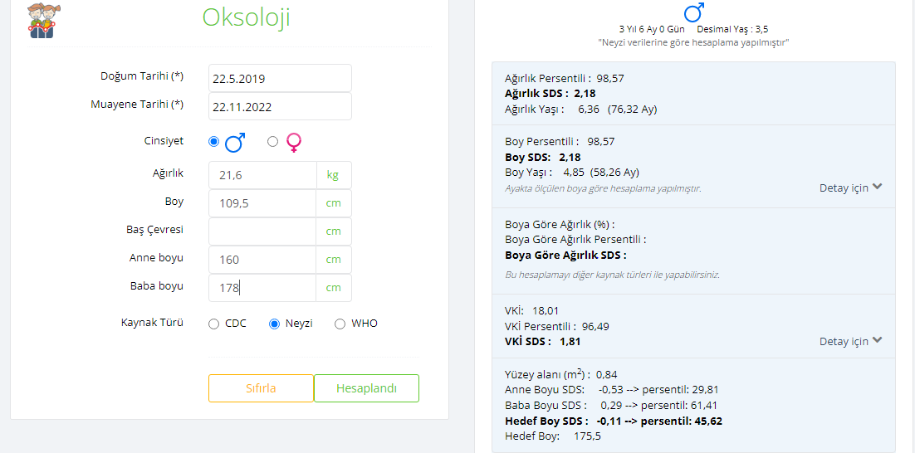

Slide 6
On his PE
Systemic examination is normal
Pubertal evaluation
Ax hairy no
Pubic hairy grade 2
Testis volume 12-10 ml
Streched penil height: 8cm

Slide 7
Pubertal physiology
Puberty is the general term for the transition from sexual immaturity to sexual maturity. There are two main physiological events in puberty:
•Gonadarche is the activation of the gonads by the pituitary hormones follicle-stimulating hormone (FSH) and luteinizing hormone (LH)
•Adrenarche is the increase in production of androgens by the adrenal cortex

Slide 8
Hypothalamic-pituitary-gonadal (HPG)
Hypothalamus
GnRH
+
Pituitary
Testosterone(-)
Progesterone(-)
Estogen (-,+)
FSH
LH
Inhibine(-)
Activine (+)
+
Gonad

Slide 9
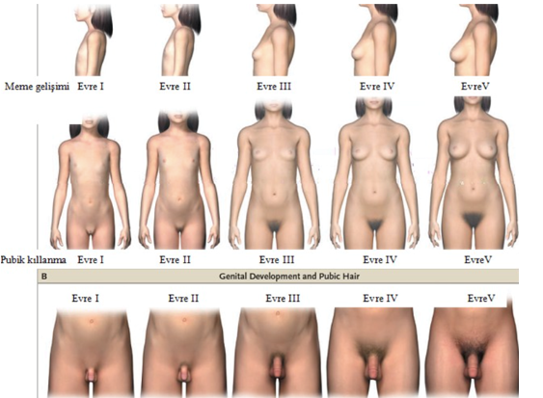

Slide 10
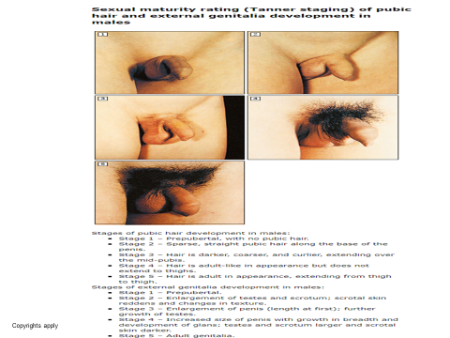

Slide 11
Tanner Staging,
Also known as Sexual Maturity Rating (SMR),
is an objective classification system that providers use to document
track the development and sequence of secondary sex characteristics of children during puberty

Slide 14
What is the secondary sex characteristics of boys?

Slide 15
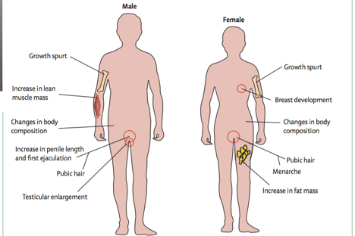

Slide 16
Laboratory Findings
TSH:1,69ıu/ml
St4:1,03ng/dl
ACTH:21,5pg/ml
Cortizol:11,56mcg/dl
FSH:1,55 mIU/ml
LH:0,53 mIU/ml(<0,3)
Testesteron:52,88ng/dl(<10)
17 OHprogesterone:0,26ng/dl
1,4 Androstenidione:0,08
DHEAS:6,2 mcg/dl

Slide 17
Bone Age
It is appropraite for 6 years for boys

Slide 18
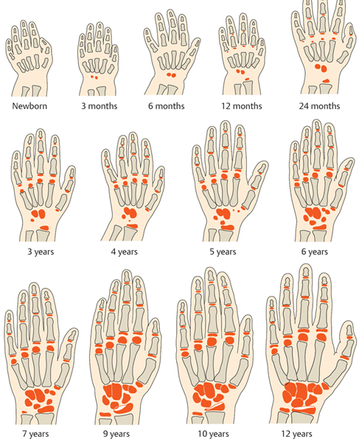

Slide 19
Please say the pathological findings

Slide 20
Is pubic hair normal at this age?
What is your opinion about tanner stage?
Hormone profile is suitable for his age?

Slide 21
Which test would you like to do next?

Slide 22
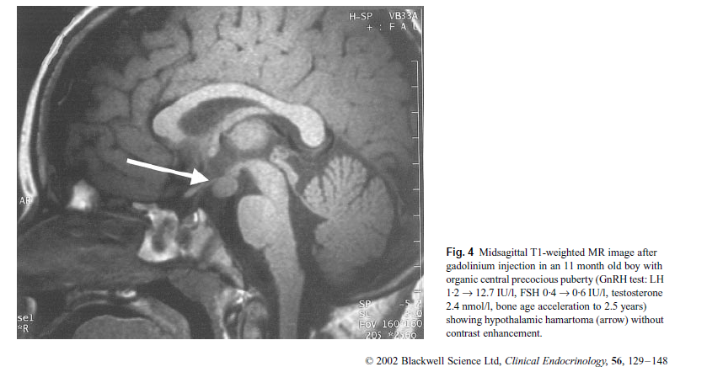
Starting from the floor of the third ventricle and extending towards the suprasellar cistern, a solid lesion of 11*14*15mm in size is observed, with smooth borders, isointense with the cerebral parenchyma in T1W sequence, slightly hyperintense in T2W sequence, and does not show staining with contrast material.

Slide 24
Hypothalamic hamartomas (HH)
HH are rare, tumor-like malformations
occur during fetal development and are present at birth.
They are non-progressive lesions and do not expand, spread or metastasize to other locations.
Two clinical phenotypes of HH are recognized:
1) central precocious puberty and
2) epilepsy and related neurobehavioral symptoms.
For those with central precocious puberty only, symptoms may occur as early as 1-3 years of age.
For those with epilepsy, gelastic (laughing) seizures are usually the first symptom, often during infancy.

Slide 25
What is the puberty precocious?

Slide 26
Precocious puberty is
As the appearance of breast development before the age of eight years in girls and
Testicular enlargement before the age of nine years in boys

