Slide 1
Self Expression and I-Language
Prof.Dr. Ayşe Tuba Altuğ
Ankara University School of Dentistry
Department of Orthodontics

Slide 2
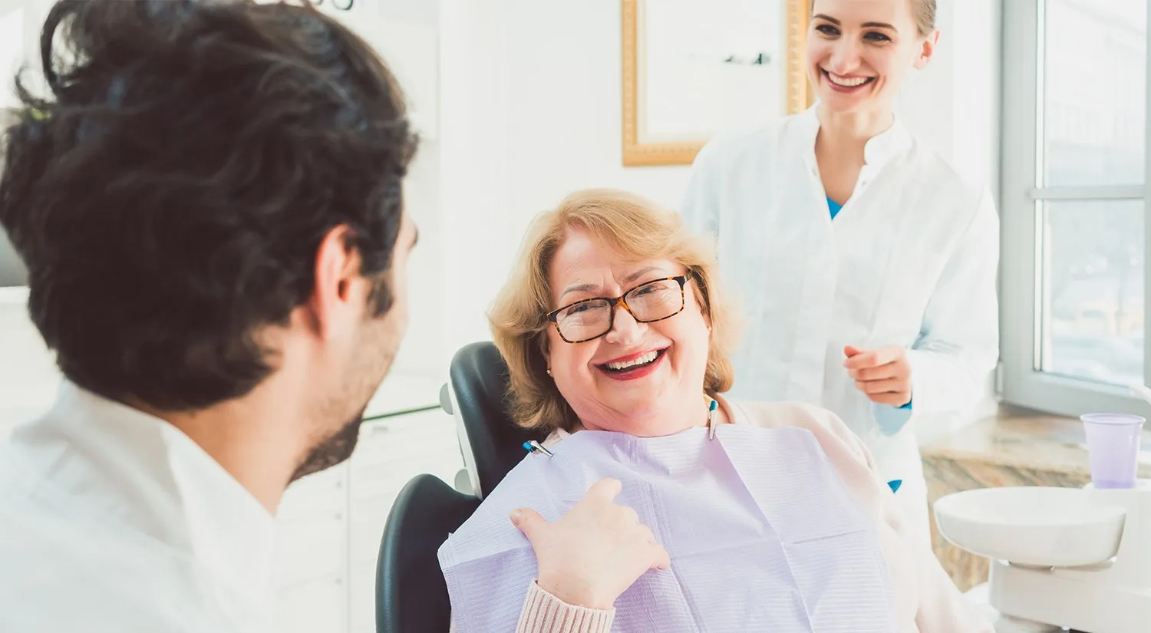
COMMUNICATION IN DENTISTRY
The greatest differences among dentists is our ability to understand patients' concerns, communicate the benefits of care, and influence them to accept it. Some dentists seem to have a gift for saying the right thing at the right time, while others can't!

Slide 3
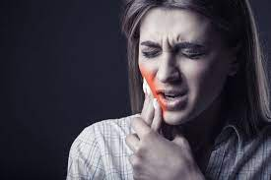
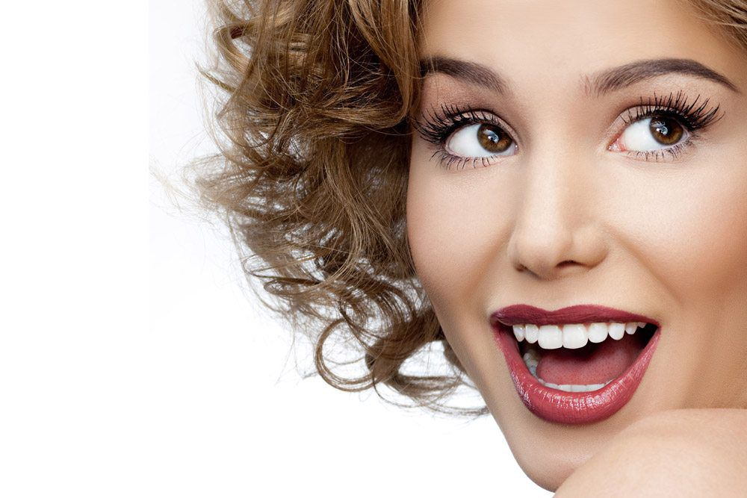
TERMINOLOGY;
What is self-expression?
We define self-expression as expressing one's thoughts and feelings, and these expressions can be accomplished through words, choices or actions.

Slide 5
TERMINOLOGY;
What is I-language?
I language is a form of expression that explains the individual's reaction to the behavior and situation, as well as his own feelings and thoughts. When we describe ourselves with “I” sentences, we do not hurt the other person, but we also give our own messages.
- I language: Your behavior hurt me, I'm sorry!

Slide 6
TERMINOLOGY;
What is You-language?
“You” language involves accusation and the other person takes a natural defense. Therefore, the result can go up to incomprehension, discussion, fight.
- You language: You are wrong! You are so wrong!

Slide 7
Using "I" language, also known as “I” statements, is a way to express your thoughts and feelings in an assertive, non-aggressive way.
“I” statements tend to make people feel less defensive and more willing to listen. This can be helpful for defusing conflicts and asserting yourself in a polite way.

Slide 10
I language: Doesn't push defensively. It doesn't feel guilty. Because the reason for the emotion is understood, communication becomes healthy. The person receiving the I message also learns to think of others. It provides closeness. It reduces conflicts. It puts the speaker at ease.
You language: It is accusatory. It is about personality rather than behavior. It makes the person feel incomprehensible. It blocks the re-talk request. It makes you not understand what you are angry about. It hurts a person. It causes resistance, that is, defensive communication. Defensive communication, on the other hand, will prevent the teaching from reaching its main purpose, as it will cause the communication to pass from the content level to the relationship level, and the relationship will turn into a war, a winning problem.

Slide 11
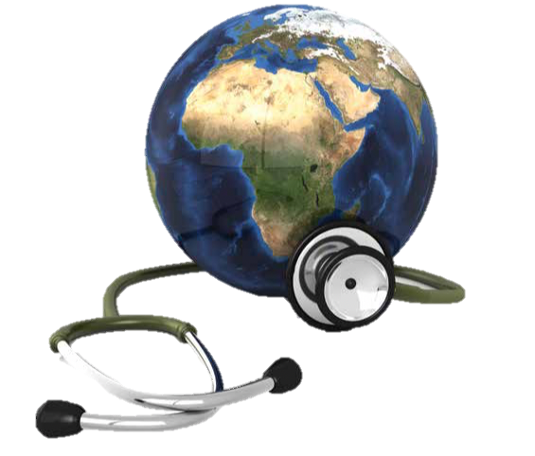
COMMUNICATION in HEALTH SERVICES
Health service delivery is an area where communication between people is the most necessary and also difficult.

Slide 12
SELF-EXPRESSION IN DENTISTY
Patient expressing her/his thoughts
Dentist expressing/sharing her/his thoughts
The patient must be able to explain her/his problem.
The dentist has to be able to convey the solution correctly, gain trust and persuade the patient.

Slide 13
WHAT IS EMPATHY?
It is the process of a person to look at the event from the person's story, and to understand the person's emotions and thoughts correctly, and to tell them.
It is not enough just to understand the feelings and thoughts of the other person. It is important to understand the feelings and thoughts of the other person correctly.

Slide 14
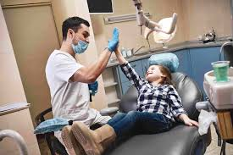
Hello, how are you today?
What is your name?
How can I help you today? Could you explain me your discomfort about your teeth?
Could you tell me what bothers you with you teeth and/or chewing, smile?

Slide 15
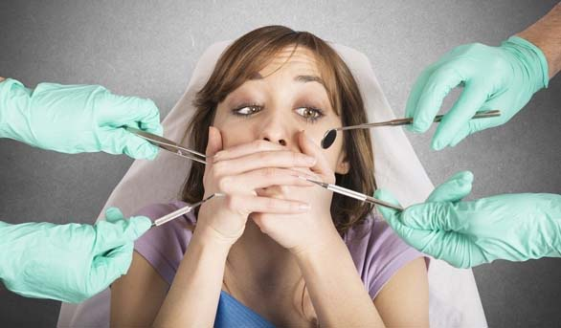
Listen to your patient! Do not jump inside the mouth ☺

Slide 16
DO NOT USE A DENTAL-MEDICAL LANGUAGE

Slide 17
Speak in their language. The patient's language is simple; we used to know it before we went to dental school.
In dental school, a different language is thought! They taught us that tooth decay was called caries, fillings were restorations, caps were crowns!
So when you say, "Mrs. Yılmaz, teeth numbers 19 and 30 have large alloy restorations with marginal caries, and they need full restorations," you might as well be talking Chinese to her! Get back to the laymen's language of dentistry - decay, fillings, infection, pus, wisdom teeth, and front and back teeth. This language may not sound scholarly to our fellow dentists at the dental society, but it sounds great to patients.

Slide 18
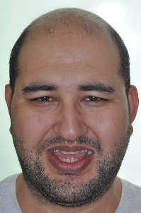
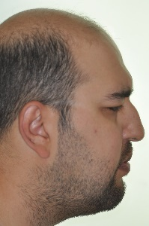
MENTAL DISORDERS

Slide 19
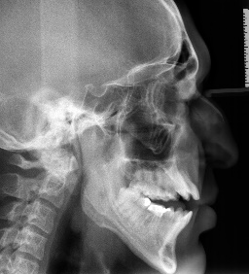

Slide 20
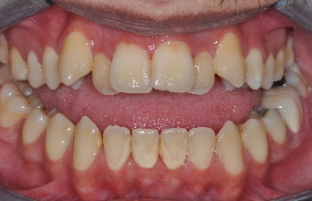
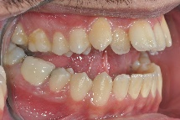
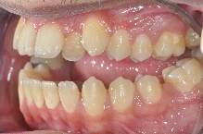

Slide 21
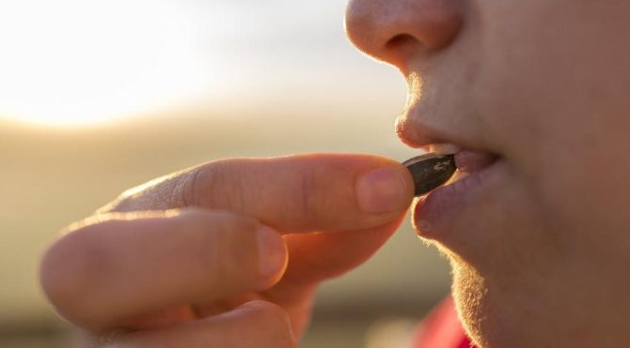
Main problem: not being able to crack sunflower seeds

Slide 22
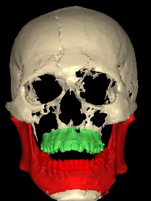
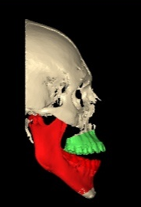
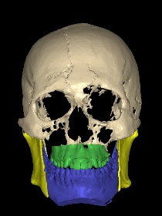
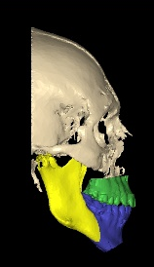

Slide 23
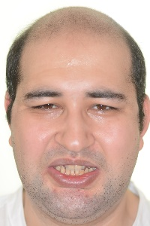
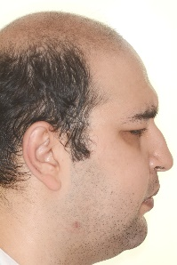

Slide 24
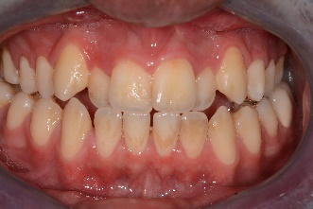
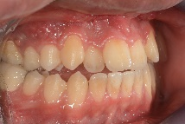
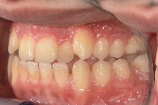

Slide 25
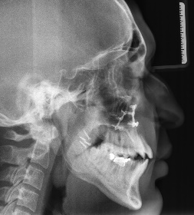

Slide 26
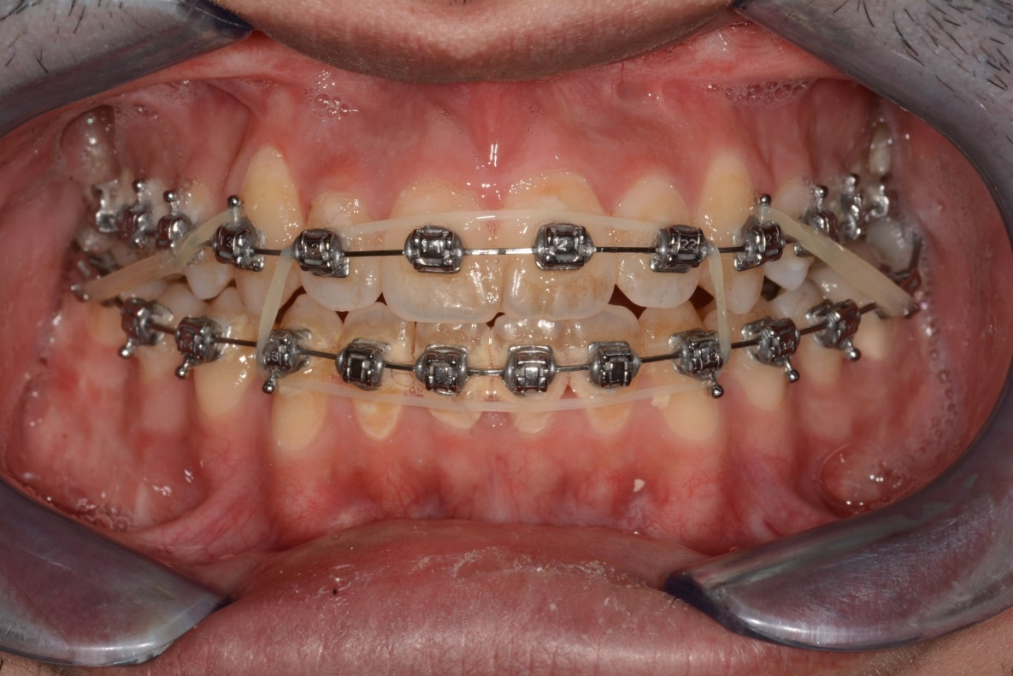
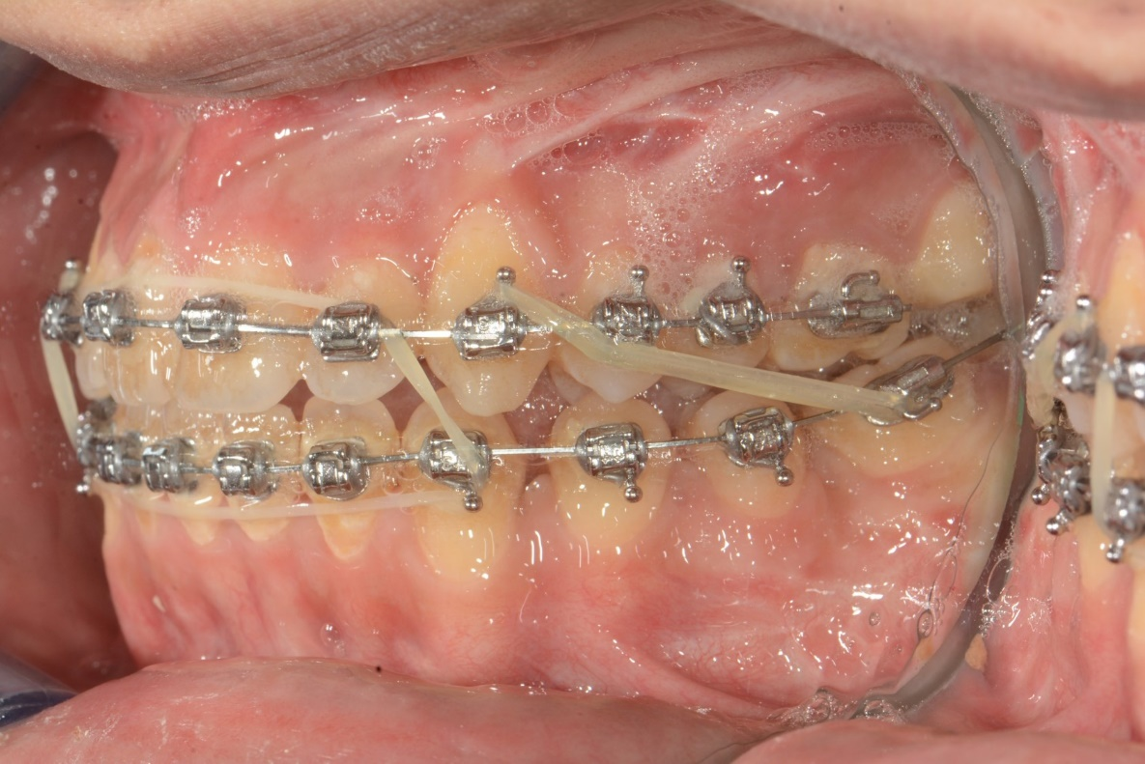
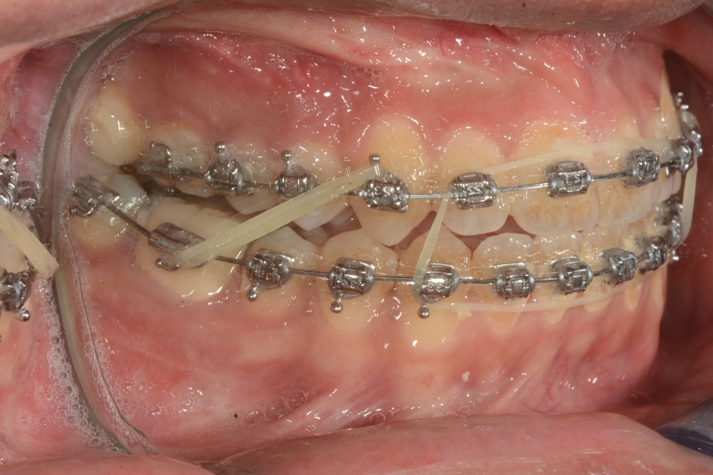

Slide 28
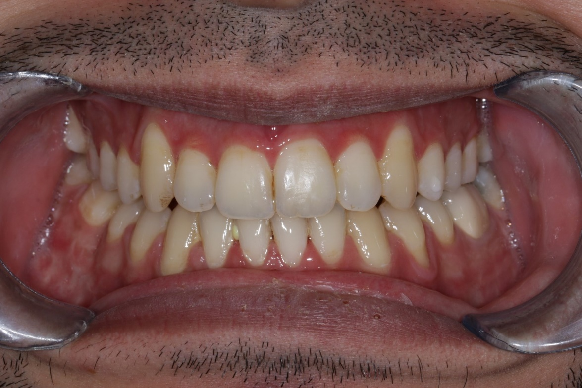
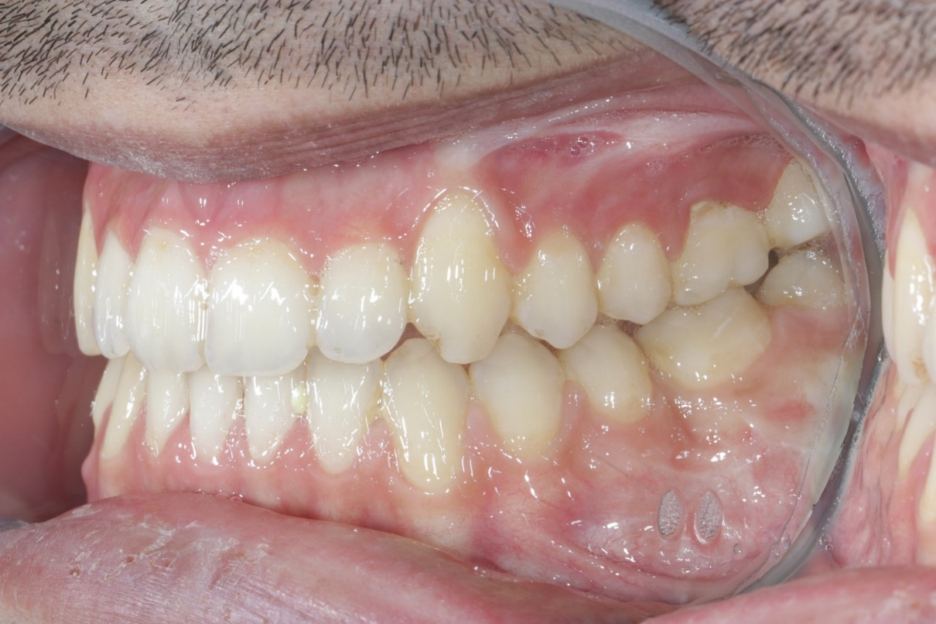
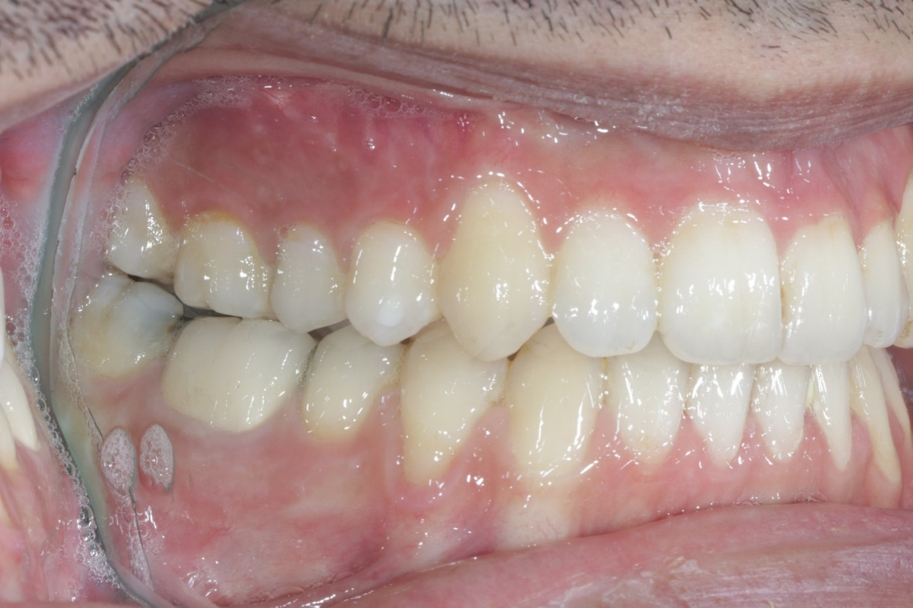

Slide 29
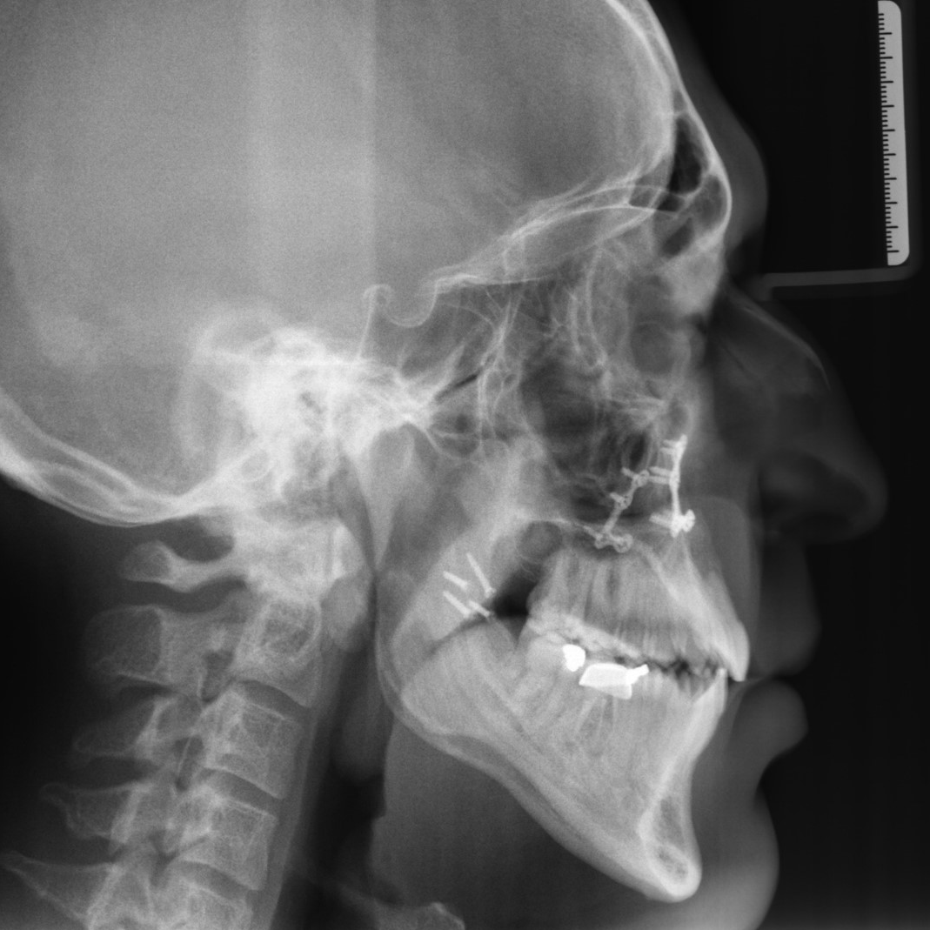
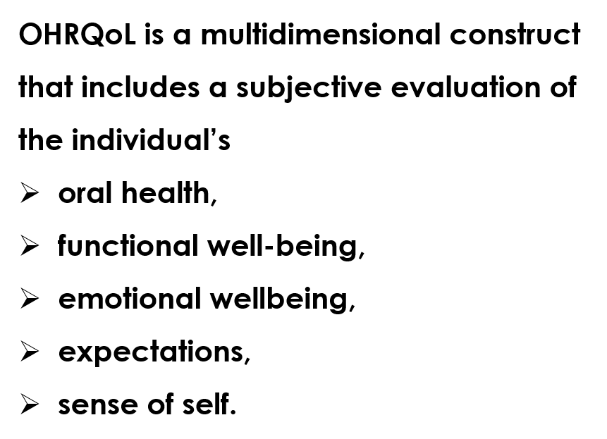
Dr. Berika Kadıoğlu

Slide 30
EXERCISES:
Dentist (You Language): You don’t brush your teeth proparly!
Dentist (You Language): Didn’t you go to a dentist ever in your life?
Orthodontist (You Language): You did not use you orthodontic elastics proparly and that’s why your treatment extended 3 more months!

Slide 31
REFERENCES:
https://www.dentaleconomics.com/science-tech/article/16385866/speak-the-patients-language
https://www.e-psikiyatri.com/ben-ve-sen-dili
https://www.uplifers.com/tartismalari-yonetmeyi-ogrenin-ben-dili-nedir/

Slide 32
Have a healthy and pleasant day ☺
Dr. Ayşe Tuba Altuğ
aysealtug@ankara.edu.tr
aysealtug@yahoo.com

